Slide 1
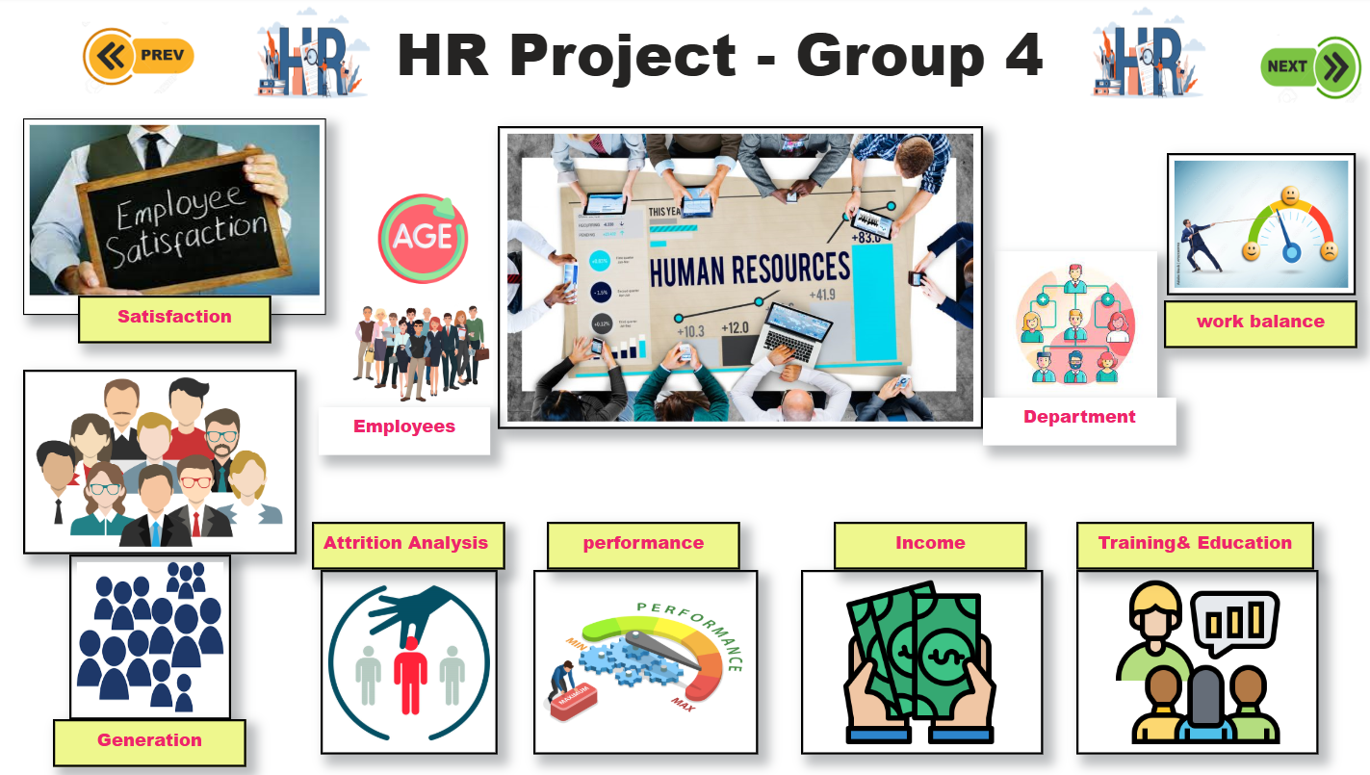
Project Name: Human Resources Dataset Analysis Group 4

Slide 2
Introduction
Employee turnover can negatively impact the workplace, reducing efficiency and productivity.
This study aims to examine the various factors that contribute to employees leaving their jobs. These factors range from external causes, such as a negative work environment that may make employees feel undervalued and unappreciated, to personal reasons, such as an imbalance between work and personal life or the desire to pursue a different career path.
Understanding these reasons is crucial for employers to take appropriate measures to create a better work environment for their employees. To achieve this, we collected relevant datasets from Kaggle containing information about employees.

Slide 3

Introduction
This project aims to develop an interactive Power BI dashboard to analyze HR data for a global digital services company such as IBM. Based on a real-world dataset with 1,470 records—including job satisfaction, working hours, promotions, and education—the project focuses on employee attrition. With no missing values and only integer and text data types, the dataset allows for smooth analysis. The main objective is to identify key factors driving employee attrition and deliver actionable insights to support HR decision-making, particularly in employee retention and workforce planning.

Slide 4
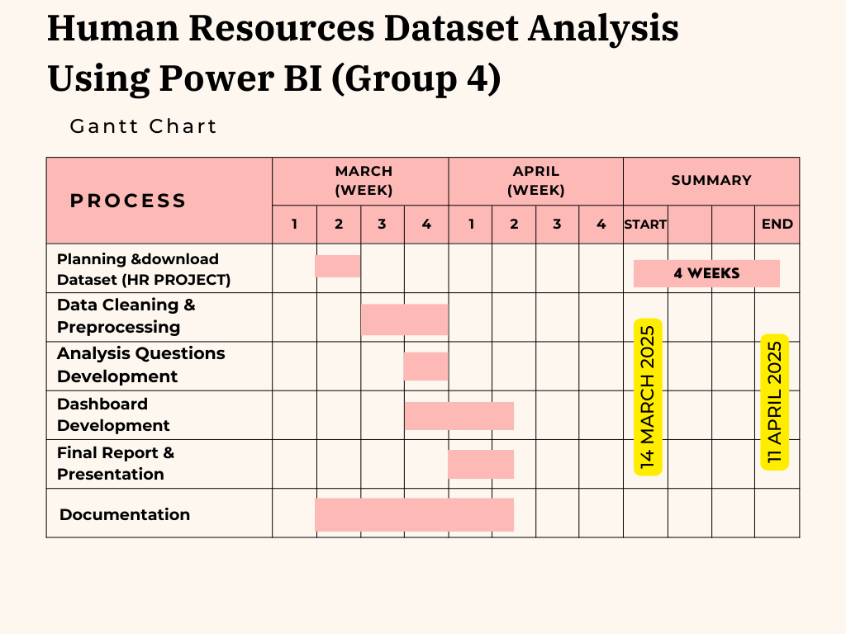

Slide 5
Main Questions
Overall Attrition Rate and Distribution:
What is the overall attrition rate in the company, and how does it vary across different departments and age groups?
Impact of Job-Related Factors on Attrition:
How do job satisfaction, work-life balance, and years of employment affect attrition rates?
Employee Distribution by Influencing Factors:
How are employees distributed by job satisfaction level, work-life balance, and education field, and does this affect attrition?
Workforce Analysis:
What is the difference between active and resigned employees in terms of years of employment, and how are they distributed by education field?
Averages of Satisfaction and Balance:
What are the average job satisfaction and work-life balance in the company?
6-Analyzing Attrition Across Generations
How do attrition rates vary across different generations, and what are the influencing factors (income, job satisfaction, age, gender)?

Slide 6
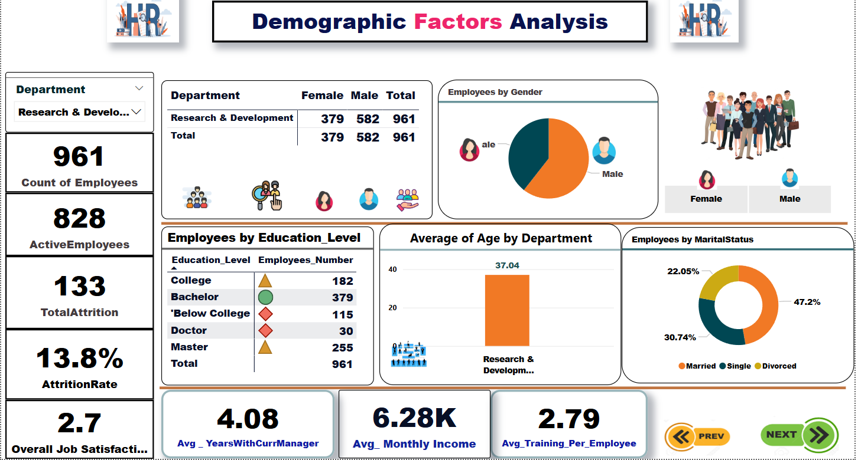

Slide 7

Main Results
Workforce Overview
The company employs a total of 1,470 staff, out of which 1,233 are currently active while 237 employees have left, indicating an attrition rate of 16.1%. This figure is relatively high and could affect workforce stability.
Demographic Distribution
Gender: Males 60% (882 employees), while females 40% (588 employees).
Marital Status: Married employees form the largest group at 45.8%, followed by singles at 31.97%, and divorced employees.
Employees By Department:
Research & Development: 961 employees
Sales: 446 employees
Human Resources: 63 employees

Slide 8
Main Results
. Education Levels
The majority of employees hold a Bachelor’s degree (572 employees), followed by Master’s (398), College-level education (282), Below College (170), and Doctorate holders (48).
. Workplace Satisfaction and Experience
Overall Job Satisfaction is relatively low at 2.7 out of 5
Average years with current manager: 4.12 years
Average monthly income: 6.5K
Average training sessions per employee: 2.8
Age Analysis by Department ( HR 37.8 years – R&D37 Years-Sales 36.5 Years)

Slide 9
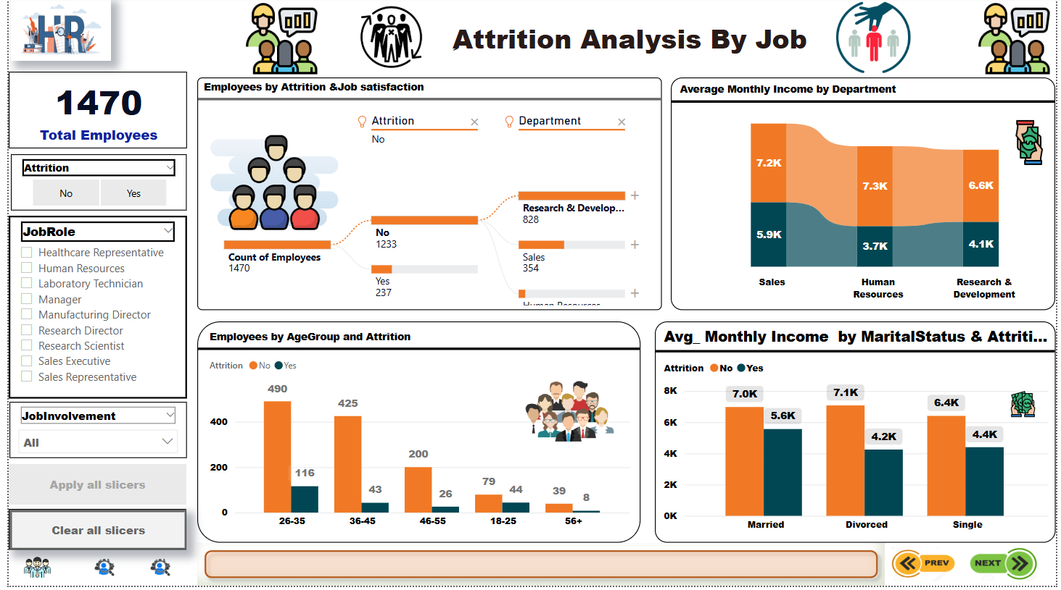

Slide 10
Main Results
Attrition vs Job Satisfaction
Attrition tends to occur more in departments where job satisfaction is lower.
The Research & Development department shows the highest employee count and notable attrition.
Average Monthly Income by Department
Employees who left the company earned significantly less than those who stayed.
Attrition by Age Group
Age group 26–35 shows the highest number of employees and the highest attrition (116 )
36–45 group also shows attrition (43 cases).
Younger (<25) and older (56+) groups have fewer attritions.
Income by Marital Status & Attrition
Lower salaries among singles and divorced employees correlate with higher attrition.

Slide 11
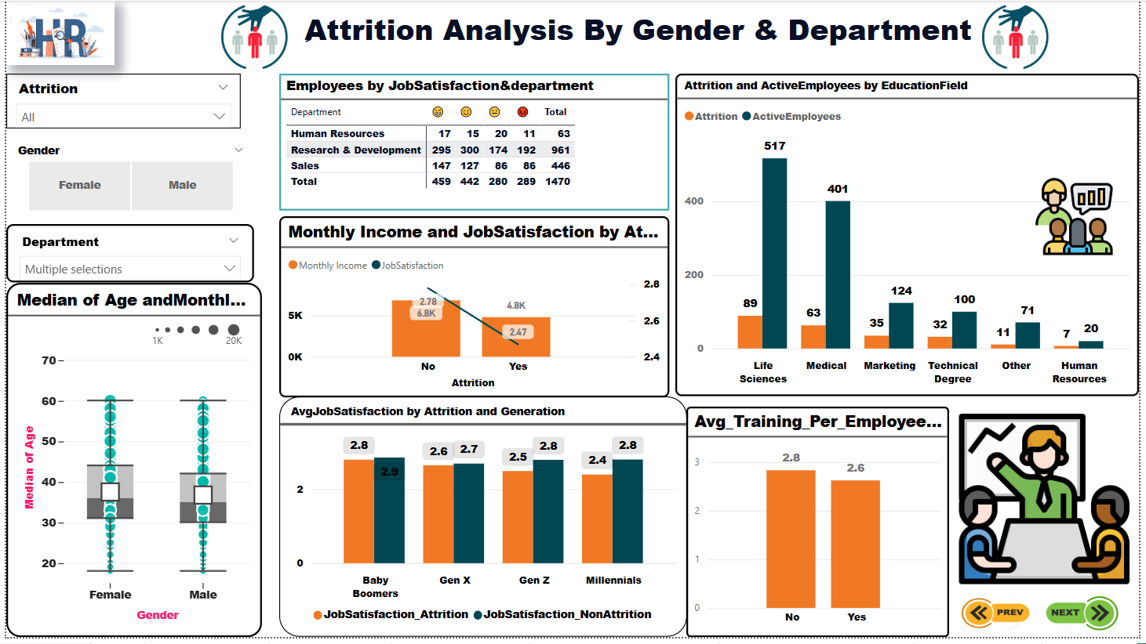

Slide 12
Main Results
Monthly Income and Job Satisfaction by Attrition
Insight: Employees who left the company had lower salaries and job satisfaction, indicating these are key factors contributing to attrition.
Attrition and Active Employees by Education Field
Insight: Highest attrition rates are seen among employees from Life Sciences and Medical backgrounds.
Job Satisfaction by Generation and Attrition
Younger generations )Millennials and Gen Z) show lower job satisfaction, especially among those who left.
Indicates a need for better engagement and motivation programs for these age groups.
Average Training Per Employee by Attrition
While the difference is small, it suggests slightly more training correlates with higher retention.

Slide 13
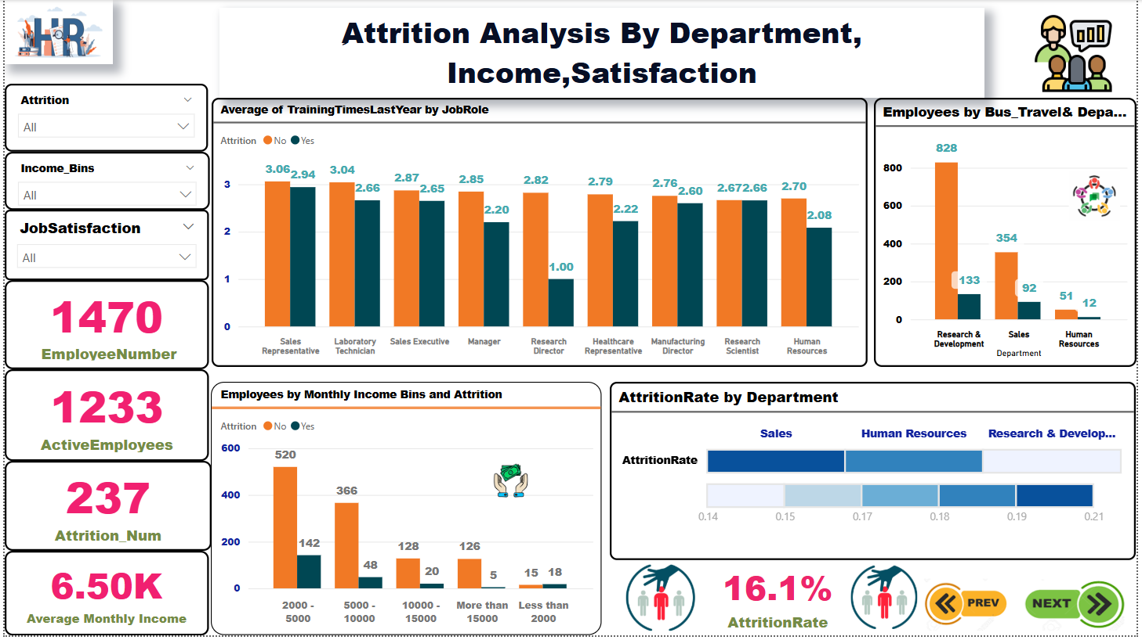

Slide 14
Main Results
Highest training averages last year were seen among:
Sales Representatives with 3.06 days.
Laboratory Technicians with 3.04 days.
Roles like Managers and Research Directors had relatively lower training averages.
The income bracket 2000 - 5000 had the highest number of resignations (142 out of 520 employees).
Higher income brackets experienced significantly lower attrition.
The Research & Development department had the most traveling employees (828).
Followed by Sales (354), while HR had the least (51).

Slide 15
Main Results
Highest attrition rate is in Research & Development: 21%.
Followed by Human Resources: 19%.
Sales has the lowest attrition rate: 14%.

Slide 16
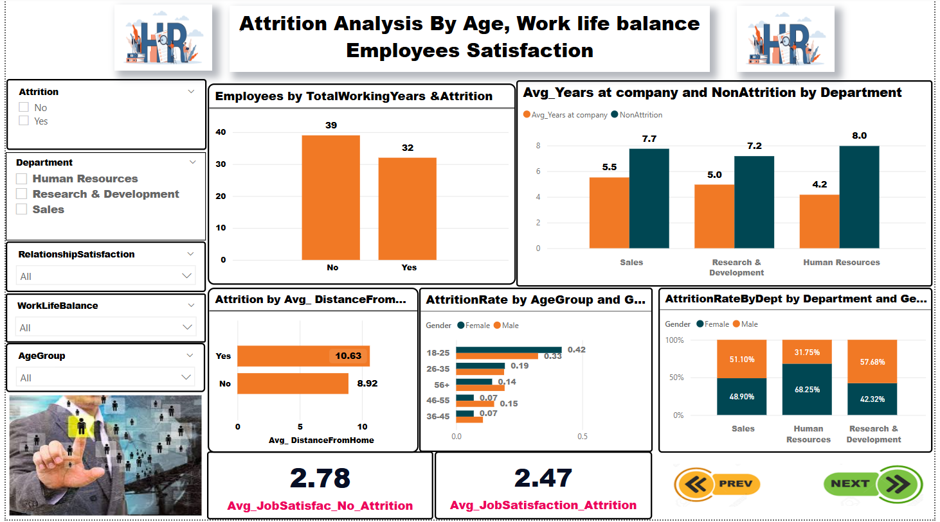

Slide 17
Main Results
Millennials and Gen Z show the highest attrition rates, while Gen X and Baby Boomers have more job stability.
Employees who stayed earn more across all generations. Gen X has the highest income, while Gen Z leavers earn the least.
Higher education correlates with lower attrition. Most employees have bachelor’s or master’s degrees.
Job satisfaction and work-life balance are below average, which may contribute to attrition.

Slide 18
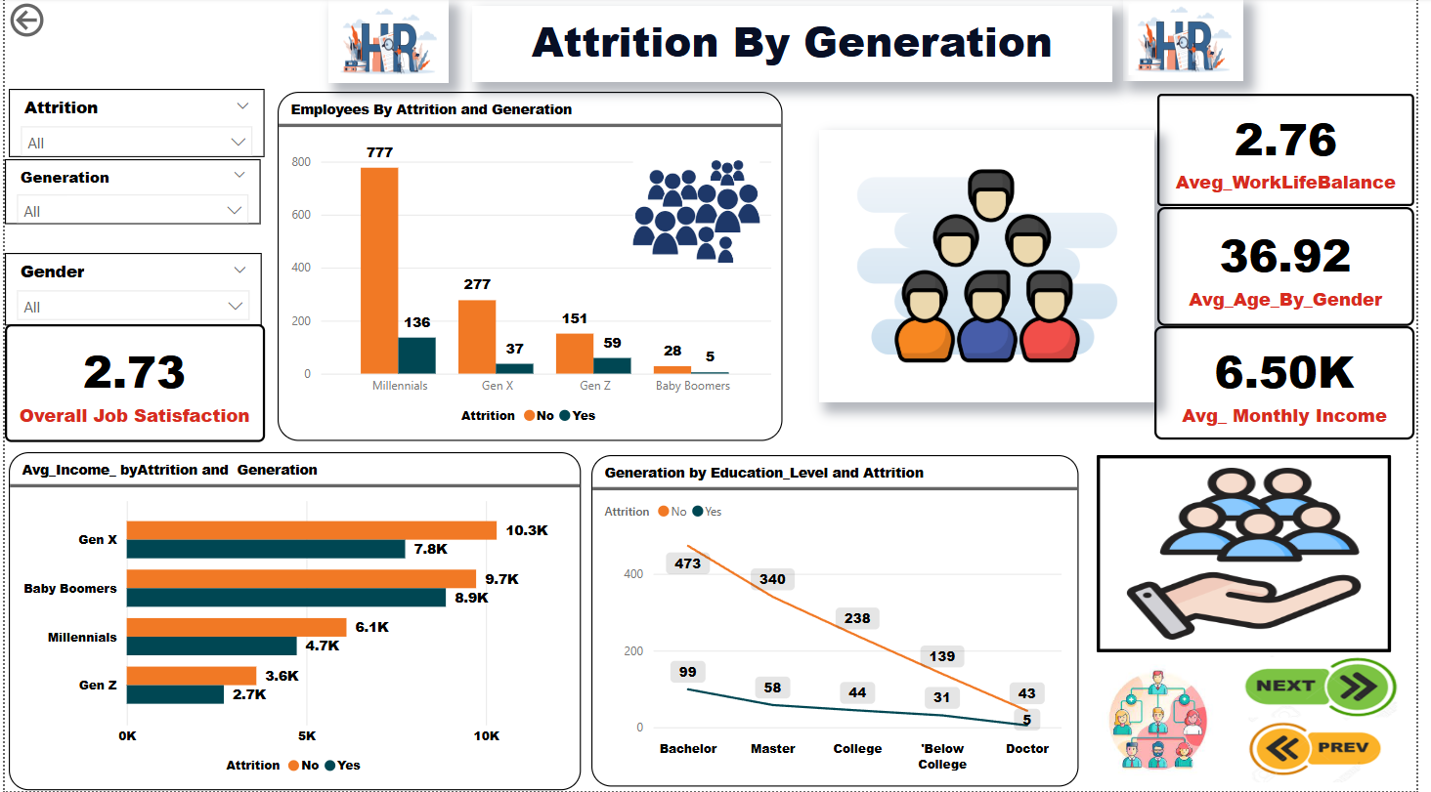

Slide 19
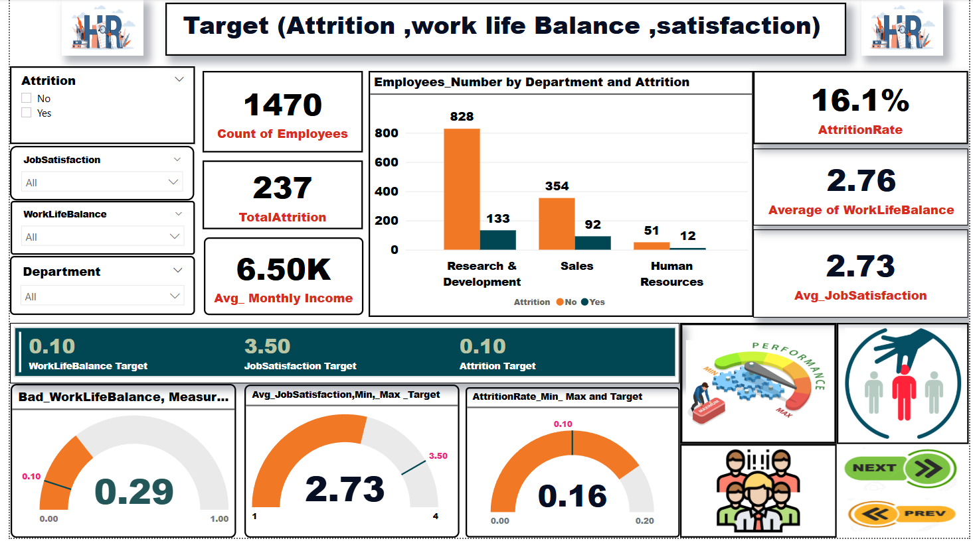

Slide 20
Main Results
The overall attrition rate remains higher than the target (16.1% vs. a target of 10%..
The Research and Development department accounts for the highest number of attritions )133 employees), followed by the Sales department.
Job satisfaction is below the target, indicating a decline in employee engagement or loyalty.
More than 29% of employees suffer from poor work-life balance, which is a critical warning sign

Slide 21

Recommendations
review salary policies, especially for employees aged 26–35.
Offer additional incentives in high-attrition departments like R&D.
Improve work environment and increase recognition programs to boost satisfaction.
Address salary disparities in departments like HR where attrition is high.
Create career advancement opportunities for mid-career employees to reduce turnover.
Improve work environment in the R&D and Medical-related departments.
Target satisfaction improvement programs for Millennials and Gen Z.
Expand training opportunities, especially for low-performing or dissatisfied employees.
Conduct regular job satisfaction surveys to identify early signs of disengagement.

Slide 22
Recommendations
Reassess work conditions in R&D to enhance employee retention.
Support low-income employees through financial incentives or improved compensation.
Align training programs with retention strategies to maximize benefits.
Review travel policies and promote better work-life balance.
Conduct regular job satisfaction surveys, especially in departments with high attrition.

Slide 23
Recommendations
Improve job satisfaction through employee engagement initiatives and feedback loops.
Introduce flexible hours and mental wellness programs to enhance work-life balance.
Provide clear career paths and mentorship for younger generations to reduce attrition.
Encourage further education to reduce attrition and enhance employee skillsets.

Slide 24
Recommendations
Prioritize interventions in R&D and Sales; conduct exit interviews to identify root causes.
Implement flexible work options and promote a supportive culture for better work-life balance.
Boost job satisfaction through recognition, training, and advancement opportunities.
Use Power BI alerts and dynamic tracking to stay aligned with targets.

Slide 25

Thank you

